Slide 1
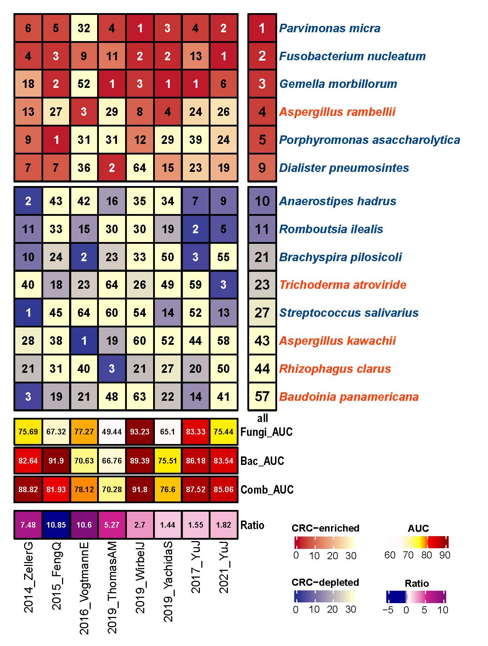
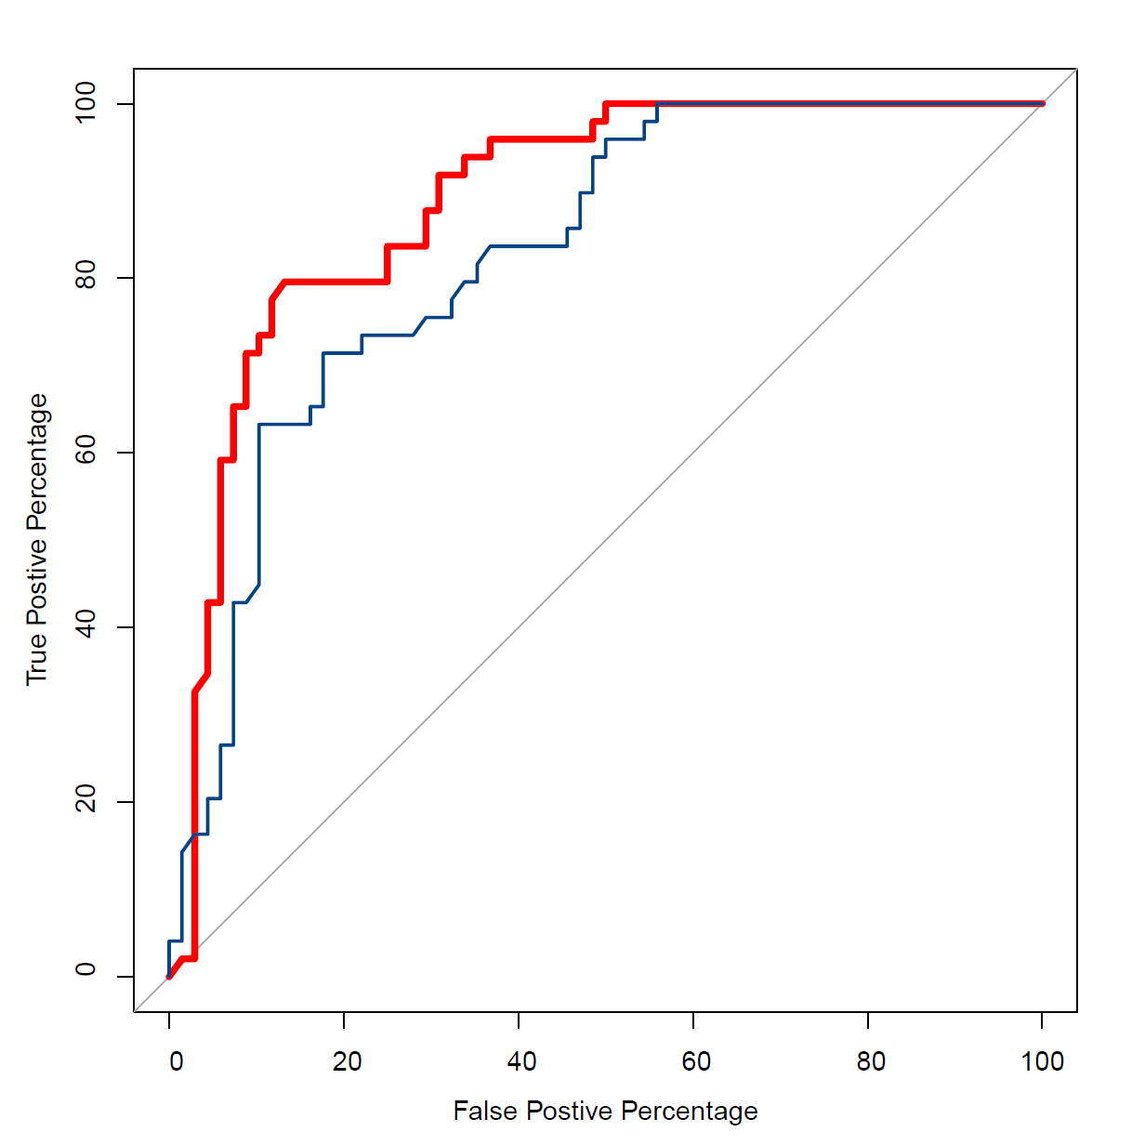
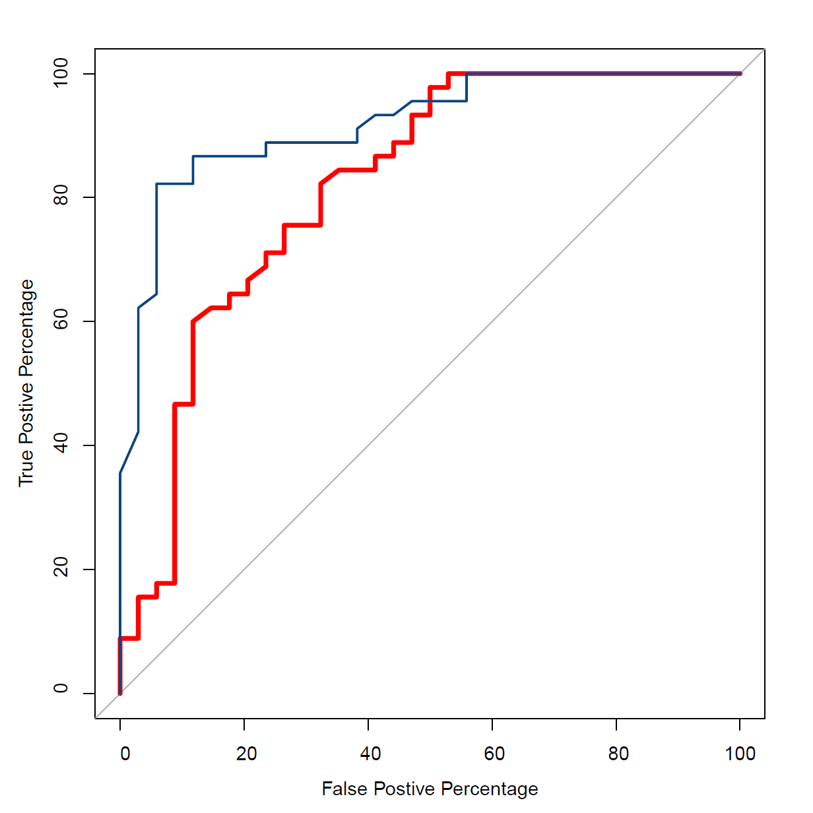
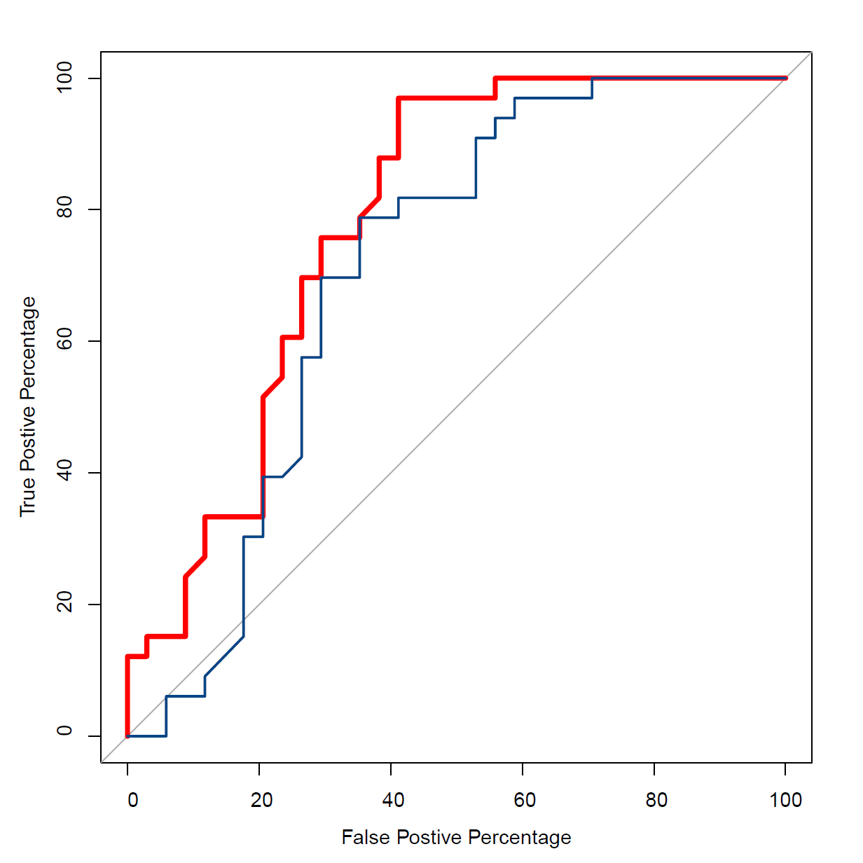
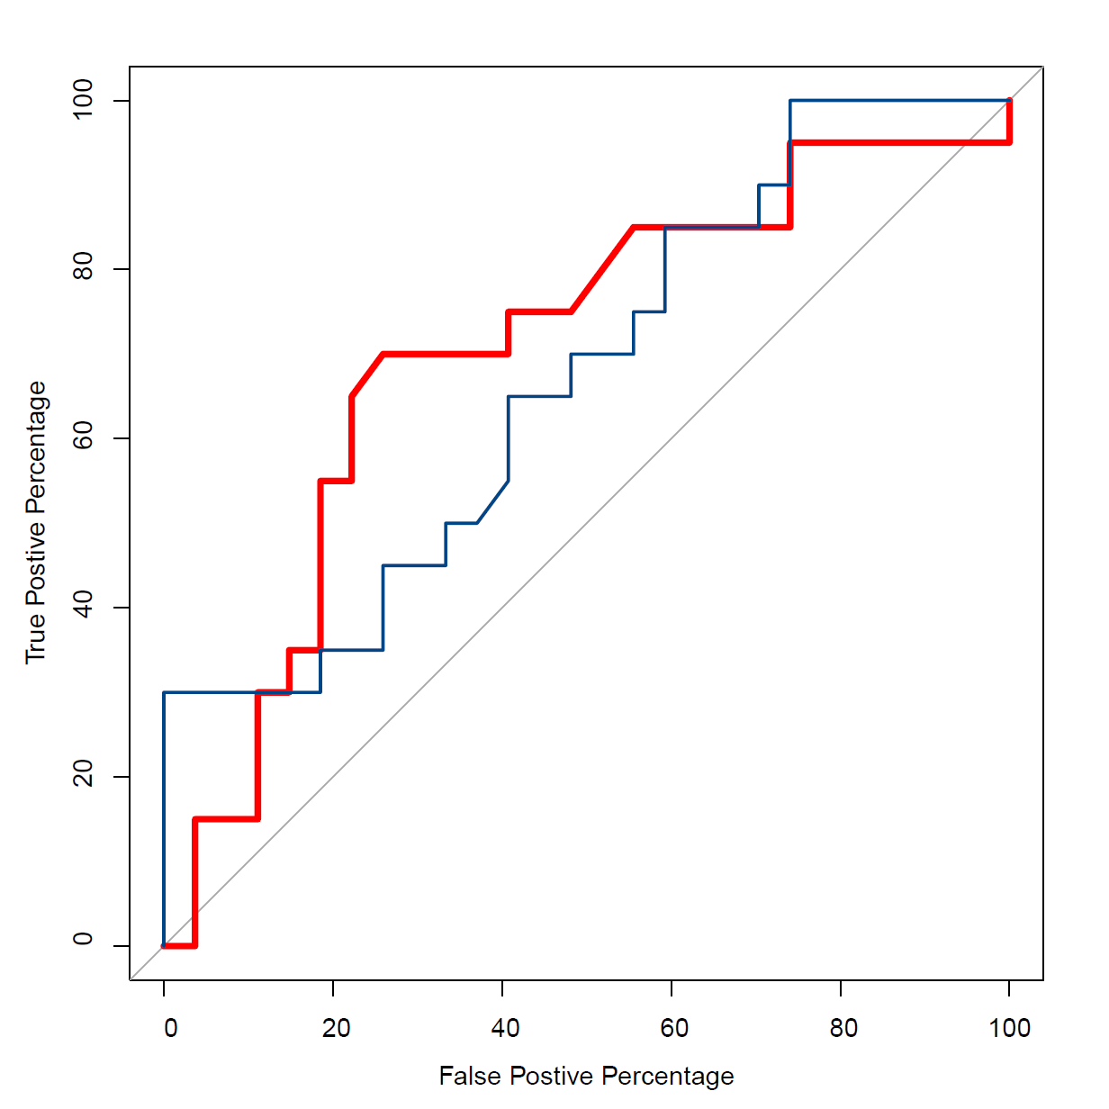
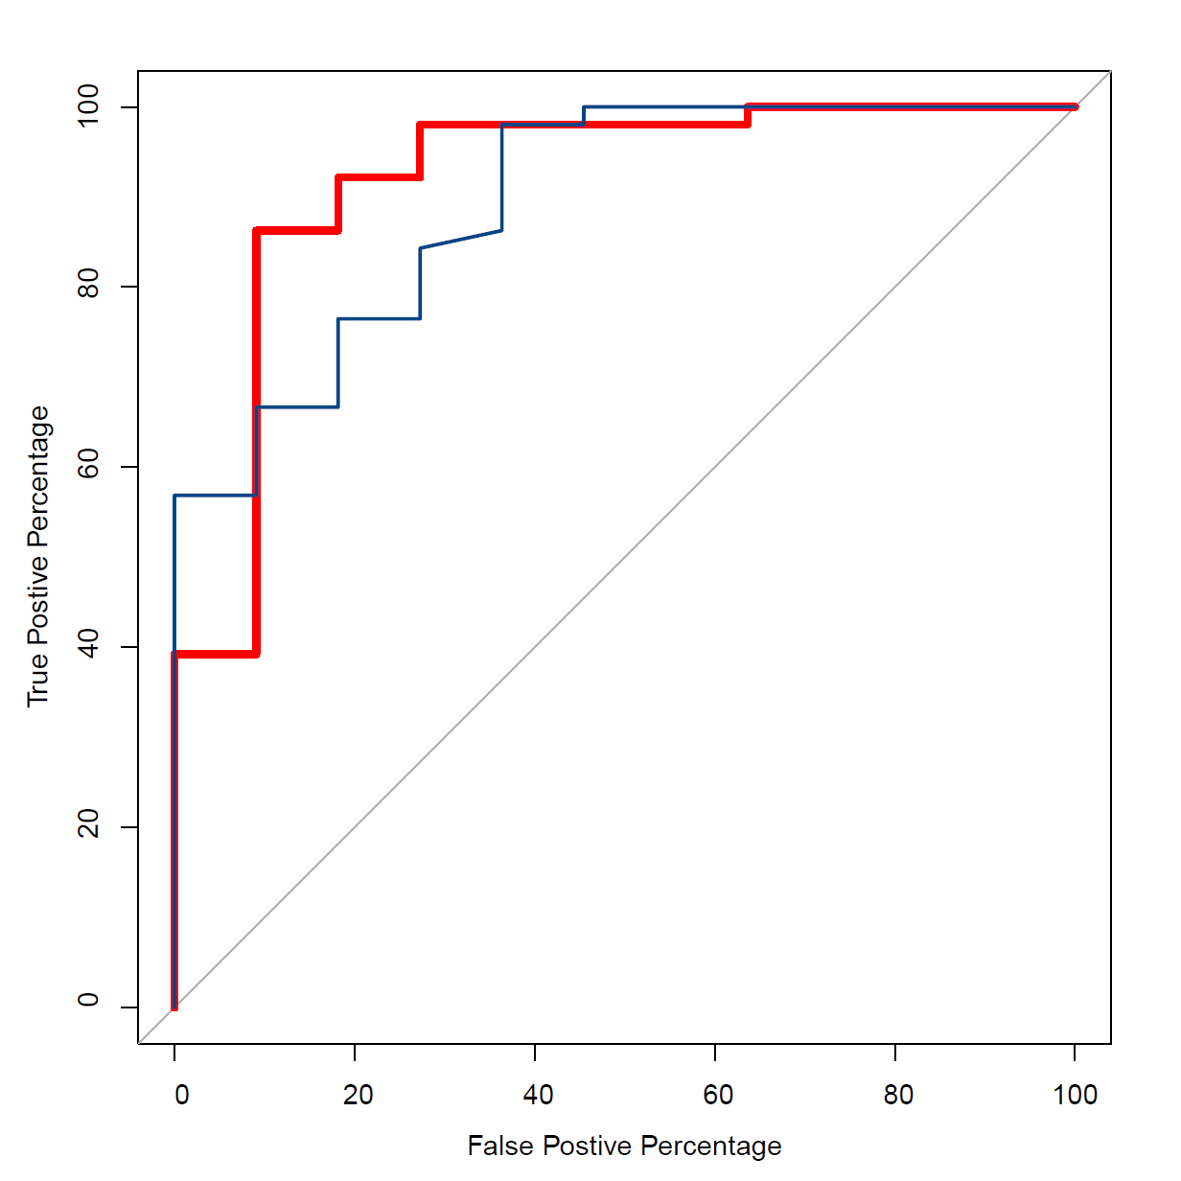
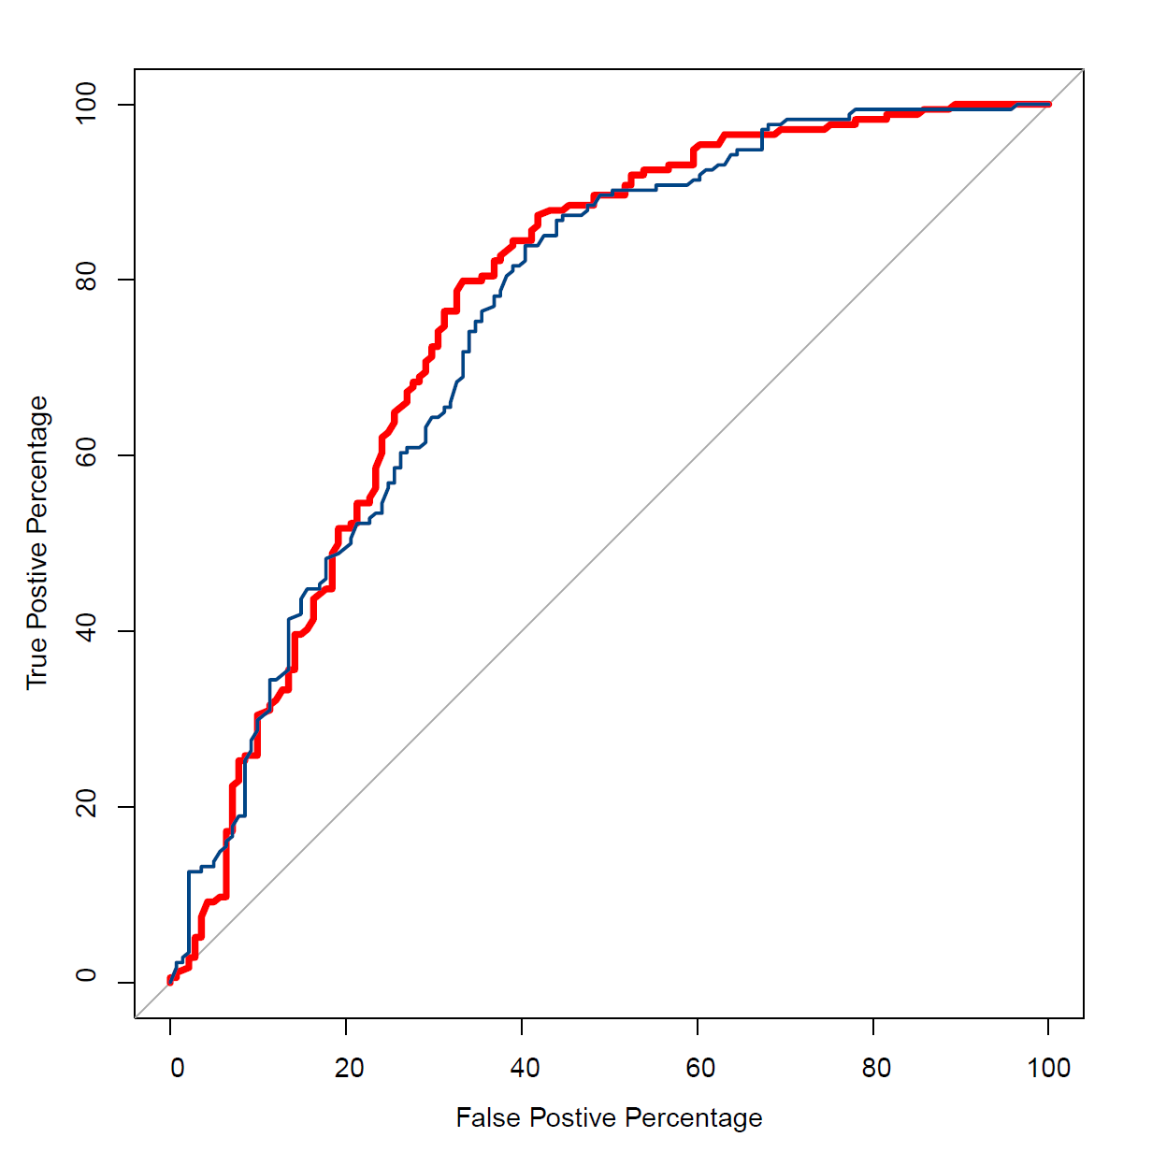
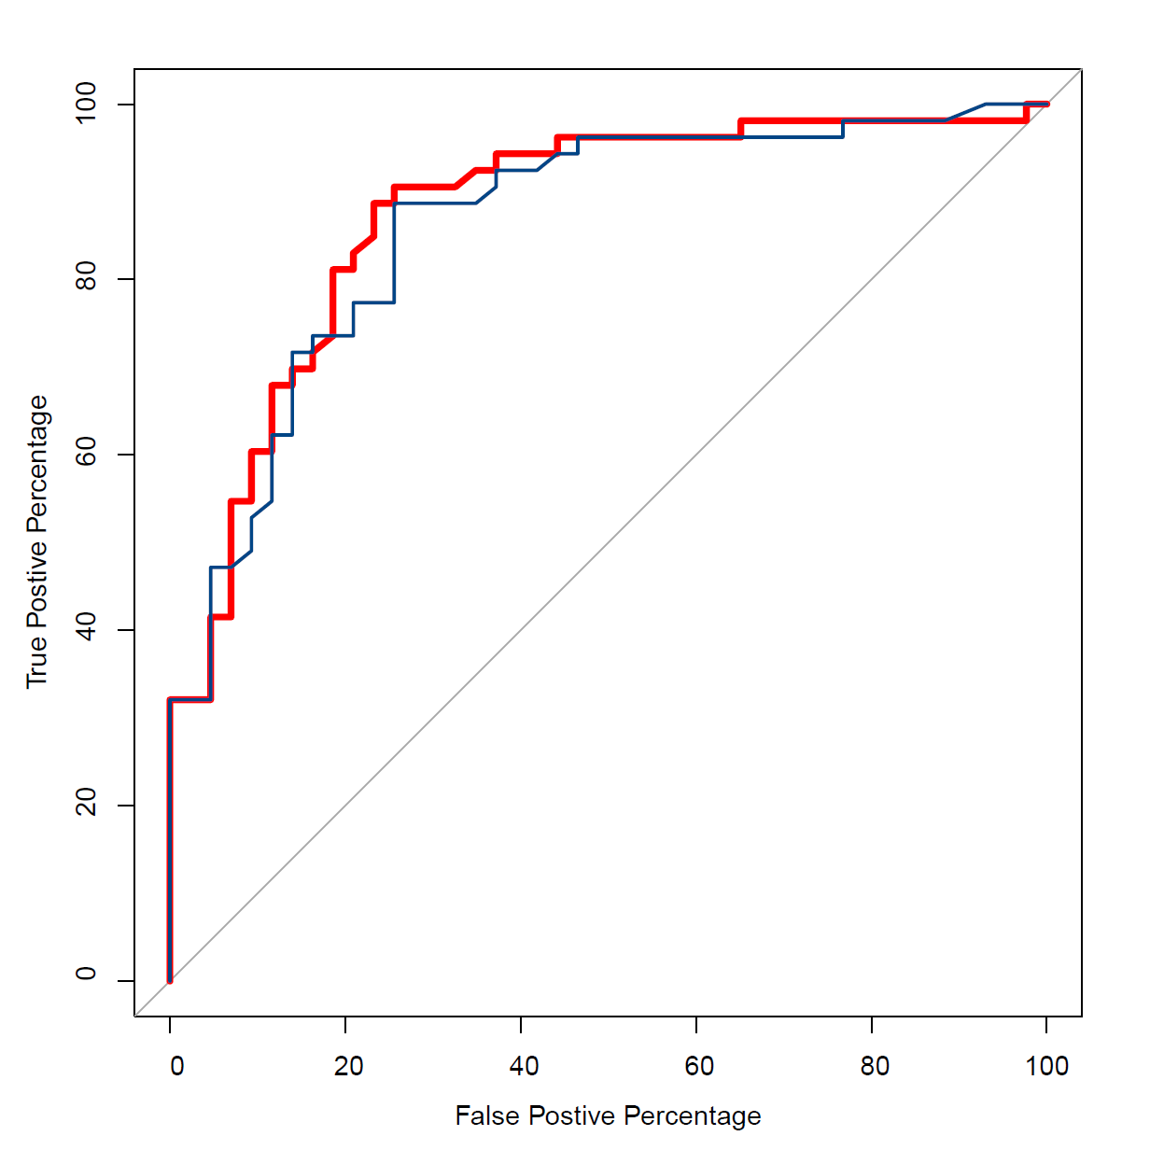
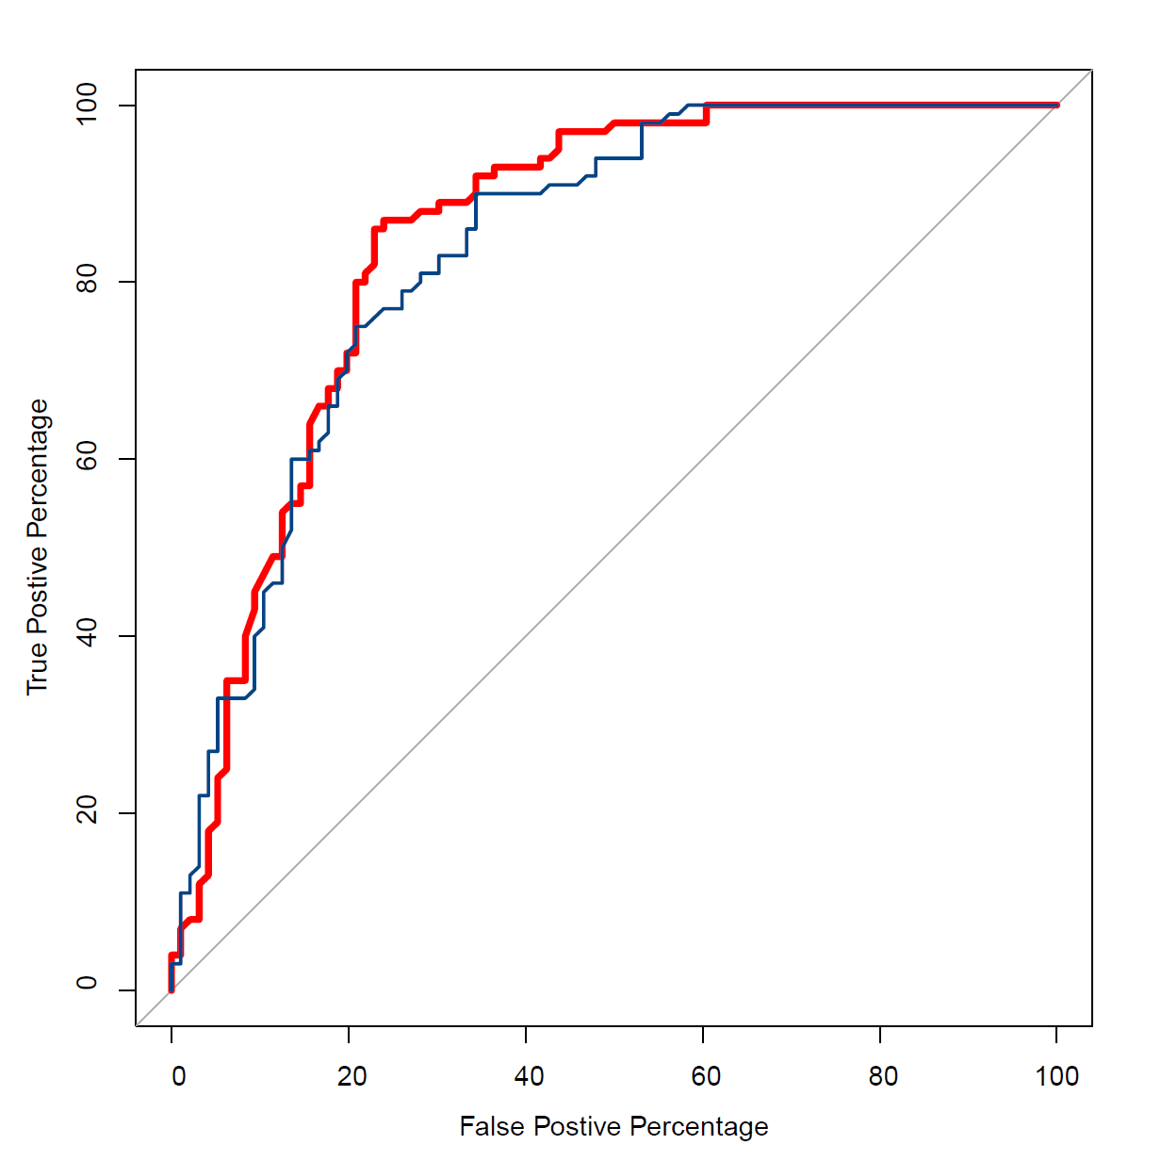


Figure 5
a
Random forest feature ranking
b
ROC in different cohorts with LOSO
True Positive Percentage
100
2014_ZellerG (EU)
2015_FengQ (OC)
80
60
40
20
Bac AUC = 82.64%
Comb AUC = 88.82%
Bac AUC = 91.9%
Comb AUC = 81.93%
0
True Positive Percentage
100
2016_VogtmannE (NA)
2019_ThomasAM (EU)
80
60
40
20
Bac AUC = 70.63%
Comb AUC = 78.12%
Bac AUC = 66.76%
Comb AUC = 70.28%
0
True Positive Percentage
100
2019_WirbelJ (EU)
2019_YachidaS (AS)
80
60
40
20
Bac AUC = 89.39%
Comb AUC = 91.80%
Bac AUC = 75.51%
Comb AUC = 76.60%
0
True Positive Percentage
100
2017_YuJ (AS)
2021_ YuJ (AS)
Relative change
80
60
$$\frac{{AUC}_{Comb}−{AUC}_{Bac}}{{AUC}_{Bac}}$$
40
20
Bac AUC = 86.18%
Comb AUC = 87.52%
Bac AUC = 83.54%
Comb AUC = 85.06%
0
0
20
40
60
80
100
0
20
40
60
80
100
True Positive Percentage
True Positive Percentage

